Slide 1
EYE PROTECTION REQUIREMENTS
OVERVIEW FOR LABORATORIES
Environmental Health & Safety
April 2026

Slide 2
FOUNDATION FOR THE POLICY
SECTION 1

Slide 3
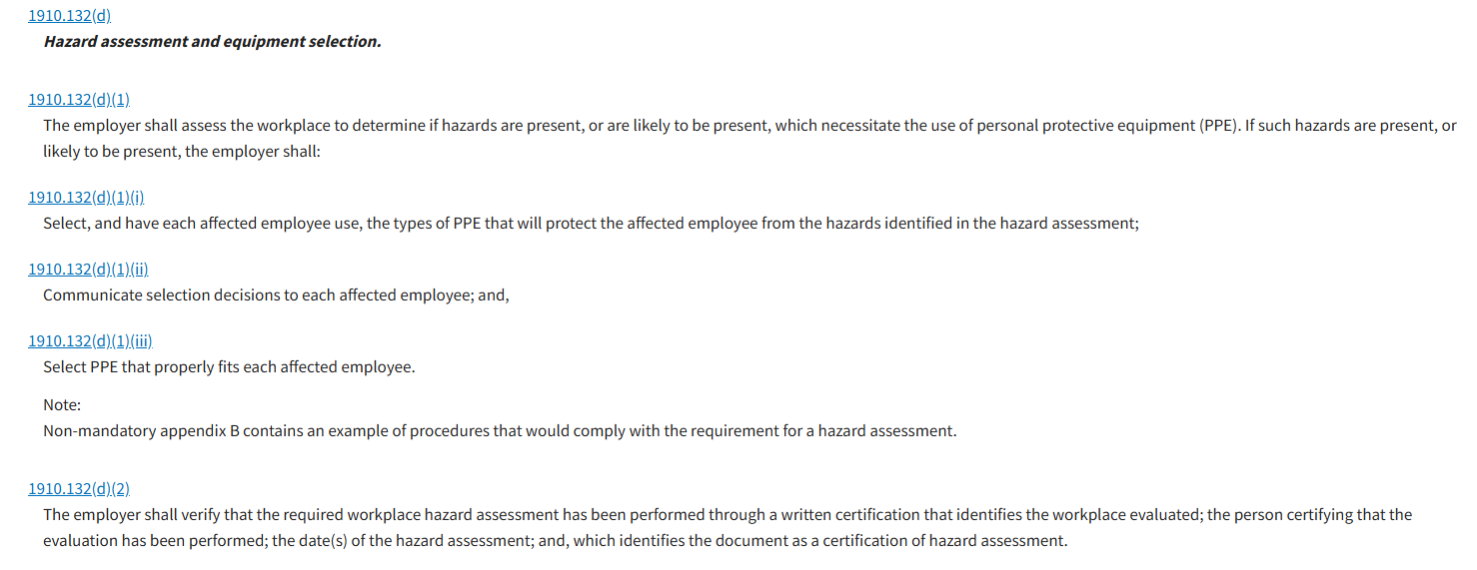
OSHA PPE Standard
FOUNDATION FOR THE POLICY
1910.132 – General Requirements

Slide 4
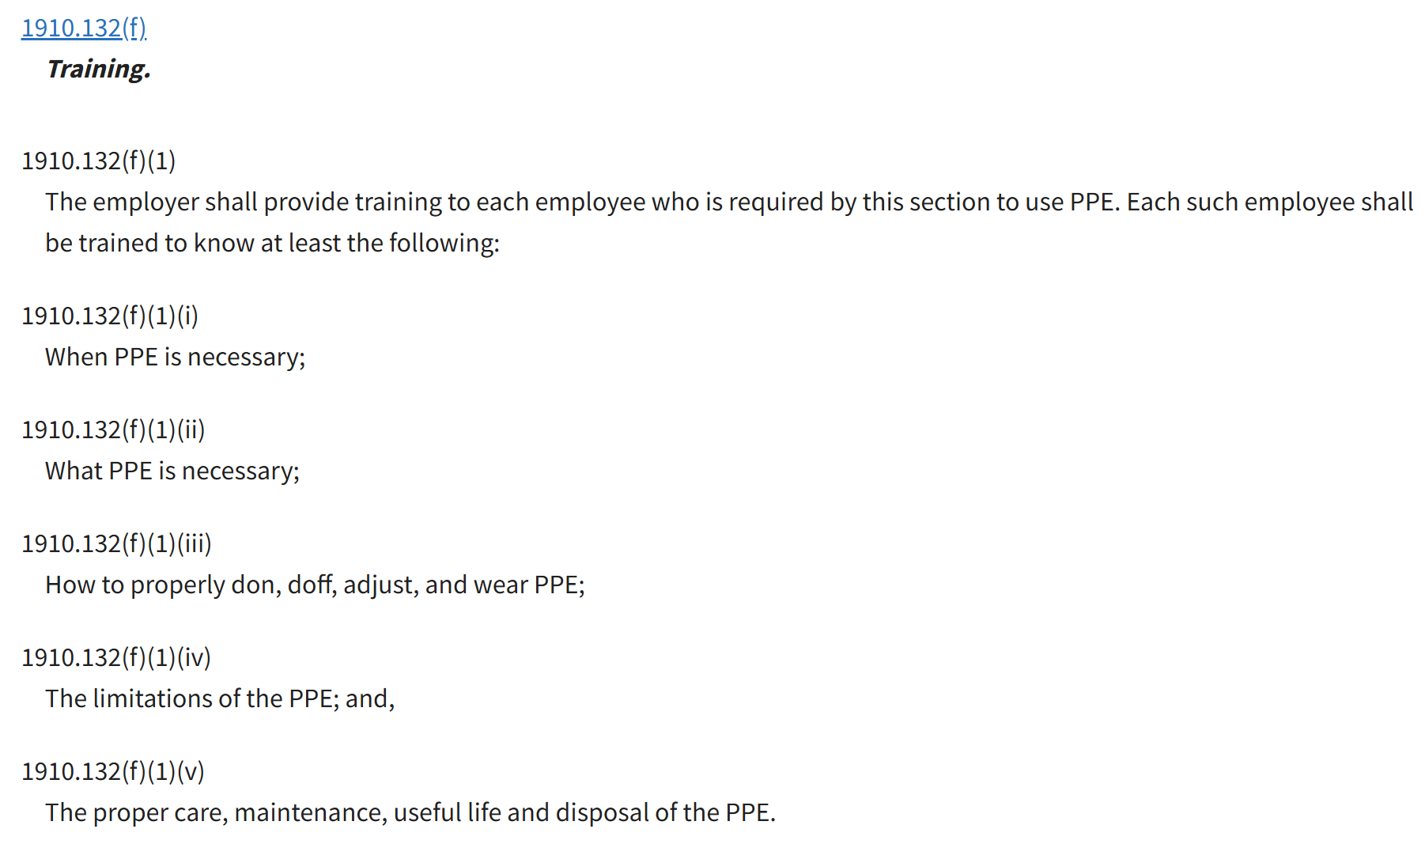
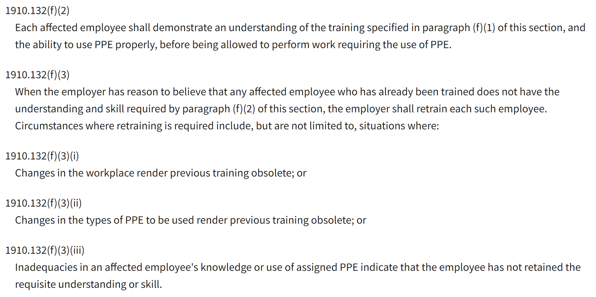
OSHA PPE Standard
FOUNDATION FOR THE POLICY
If evaluated on a case-by-case basis, extensive documentation is required by the supervisor (PI).
1910.132 – General Requirements

Slide 5
OSHA PPE Standard
FOUNDATION FOR THE POLICY
1910.133 – Eye and face protection
Flying particles: centrifuge failure, removing vials from LN2, dropping glassware, systems under vacuum or pressure
Liquid chemicals: broad, encompasses all chemicals in liquid form
Acids or caustics liquids: bleach, acetic acid (1416 entries*), phenol (831 entries*), sodium hydroxide (611 entries*), hydrochloric acid (417 entries*), hydrogen peroxide (283 entries*)
*Chemical inventory entries for the College of Medicine – mostly biomedical labs with “low” chemical usage

Slide 6
Additional Regulations/Publications
FOUNDATION FOR THE POLICY
CDC’s Biosafety in Microbiological and Biomedical Laboratories
OSHA’s Bloodborne Pathogens Standards
OSHA’s Lab Standard
National Research Council’s Prudent Practices in the Laboratory

Slide 7
Beyond Regulation
FOUNDATION FOR THE POLICY
A safety process is not accomplished simply to comply with government mandates or standards. It is achieved by the people and for the people whose safety and health it protects.

Slide 8
GAPS AT UF
SECTION 2

Slide 9
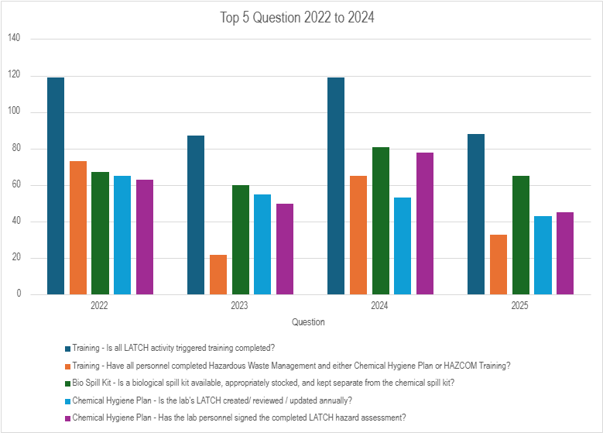
Top Inspection Findings – Sample College
GAPS AT UF
4 out of the 5 top inspection findings are related to training and hazard assessment deficiencies - essential elements of the OSHA PPE Standard

Slide 10
Incidents Involving Eyes & Face
GAPS AT UF
Date | Type | Wearing eye protection? | Department
Mar-26 | Chemical splash to eye | Y | LS-Chemistry
Mar-26 | Chemical vapor to eye | N | AG-Forest, Fisheries & Geomatic Science
Feb-26 | Laser light to eye | N | LS-Physics
Nov-25 | Chemical splash to face | Y | LS-Chemistry
Oct-25 | Chemical splash to face | Y | LS-Chemistry
Oct-25 | Fertilizer in eye | N | IFAS REC
Aug-25 | Chemical splash to eye from mouse procedure | Y | SR-Neuroscience
Jul-25 | Chemical splash to face | Y | LS-Chemistry
Jun-25 | Acid splash to eye | N | IFAS REC
May-25 | Particle in eye from mouse procedure | N | DN-Oral & Maxillofacial Surgery
May-25 | Chem splash in eye from failed bottle | N | MD-Biochemistry
Apr-25 | Struck by item in eye | N | Animal Care Services
Dec-24 | Chemical fumes in eye from nearby activity | N | AG-Horticulture
Dec-24 | Bleach splash in eye | N | AG-Microbiology
24-Oct | Animal urine sample splash to eye | N | VM-Comp, Diag & Pop Med
1-Aug | Chemical splash to face | Y | LS-Chemistry
Aug-24 | Acid splash to eye | N | EG-Chemical Engineering
Jul-24 | Cells splashed into eye during mouse procedure | N | MD-Neurological Surgery
18 eye & face incidents in labs self-reported in 21 months.
67% were not wearing eye protection
These were voluntarily self-reported and EH&S expects more incidents have occurred that were not reported.

Slide 11
BENEFITS OF PROPOSED SOLUTION
SECTION 3

Slide 12
A Simpler Approach
BENEFITS OF PROPOSED SOLUTION
Reduces administrative burden for labs to document, conduct training, and verify employee understanding – more complexity on a case-by-case basis.
  Training conducted at the EH&S level vs. lab-specific training for each experiment or process
Removes confusion and misunderstanding
  Clear expectations for when PPE must be used.
Behavior-based safety – actions are influenced by environment
  “If everyone is wearing PPE, I am more likely to wear PPE”
  EH&S is consulting with Dr. Nicole Gravina, Associate Professor, Department of Psychology who specializes on behavior-based training

Slide 13
BENCHMARKING
SECTION 4

Slide 14
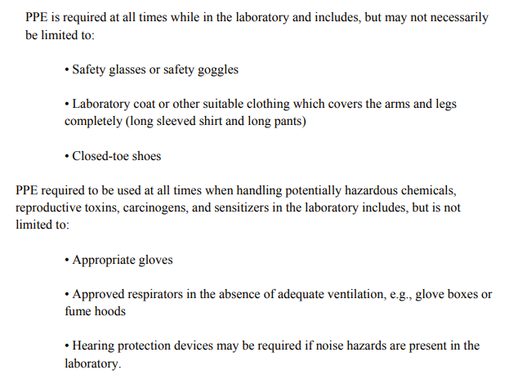
UCF
BENCHMARKING
https://ehs.ucf.edu/wp-content/uploads/sites/3/2021/08/Laboratory-Safety-Manual-2018.pdf

Slide 15
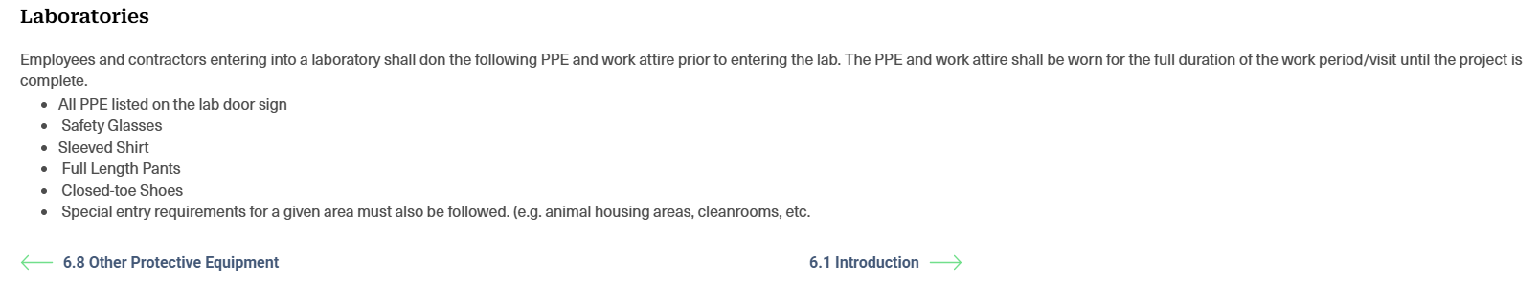
University of Michigan
BENCHMARKING
https://ehs.umich.edu/csp/6-9-site-specific-ppe-requirements/

Slide 16
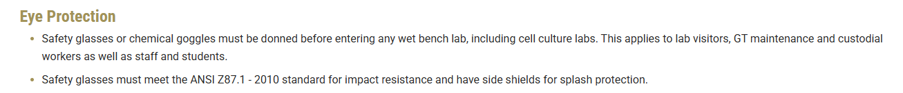
Georgia Tech
BENCHMARKING
https://ehs.gatech.edu/personal-protective-equipment

Slide 17
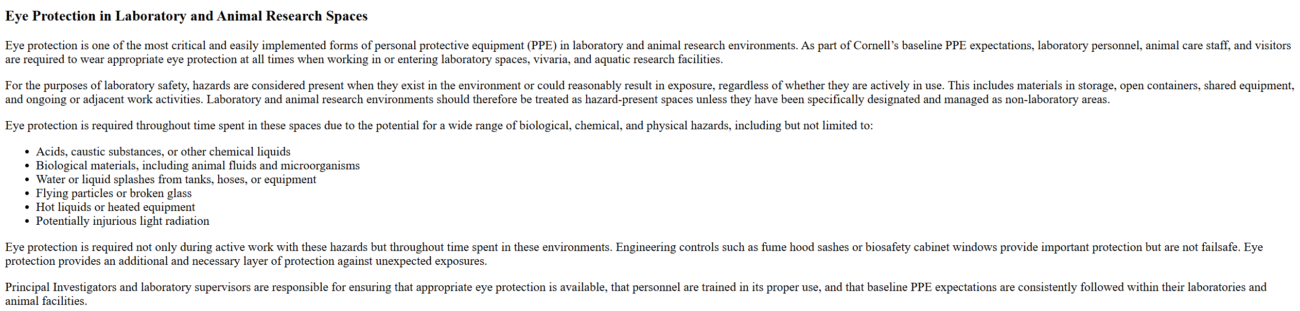
Cornell University
BENCHMARKING
https://ehs.cornell.edu/book/export/html/1022

Slide 18
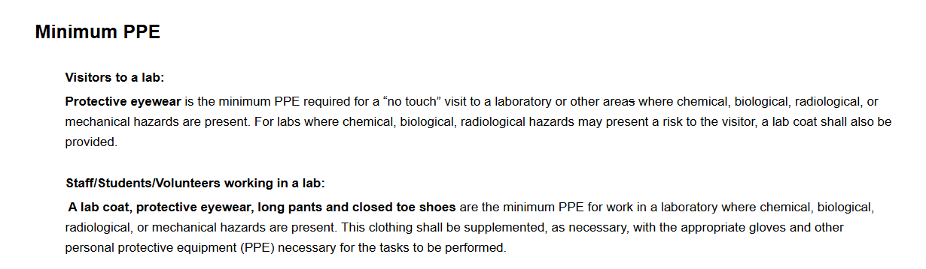
NC State
BENCHMARKING
https://ehs.ncsu.edu/laboratory-safety/personal-protective-equipment-requirements-for-laboratories/

Slide 19
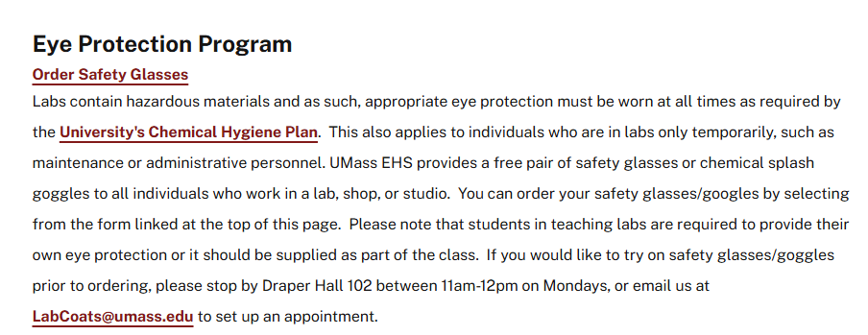
UMass Amherst
BENCHMARKING
https://www.umass.edu/ehs/eye-protection-program

Slide 20
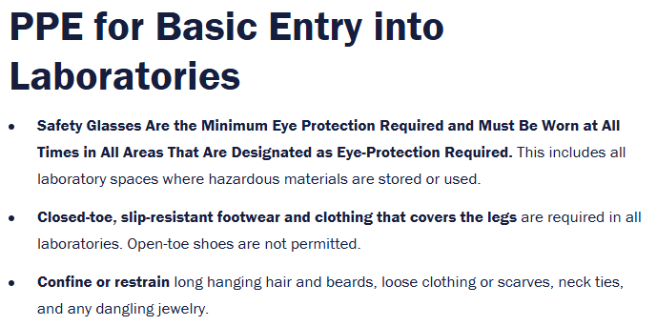
University of Virginia
BENCHMARKING
https://engineering.virginia.edu/department/chemical-engineering/safety/ppe-and-attire

Slide 21
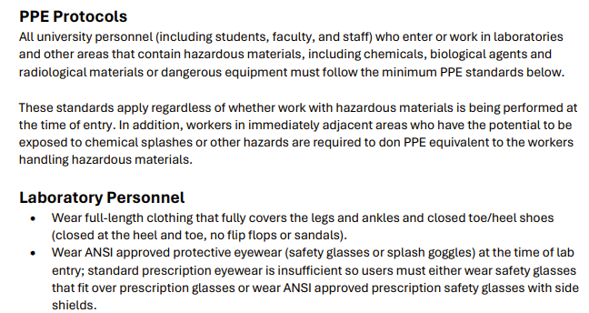
University of Idaho
BENCHMARKING

Slide 22
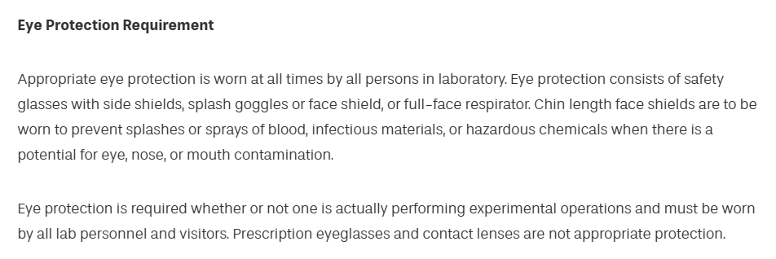
Drexel
BENCHMARKING

